Slide 1
Sugar pine
Demographic status, trajectory, and stressors
Notes:
Premise of this work is an NPS funded project focused on conservation of sugar pine
Also going to be a dissertation chapter
Would like to publish the manuscript in a journal, present at a conference
Feedback on: framing the project for a journal article, all aspects of the presentation

Slide 2
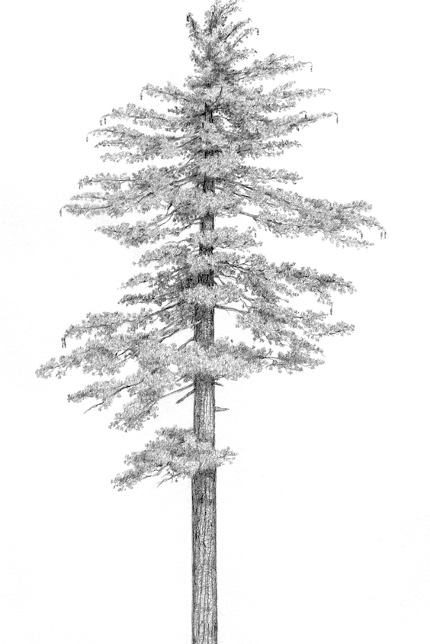
Pinus lambertiana (sugar pine)
5-25% of basal area in the mixed conifer forest type in CA and OR
Valuable food source for wildlife
The largest member of Pinus, the “Queen of the Sierra”
Facing numerous threats
Matt Strieby

Slide 3
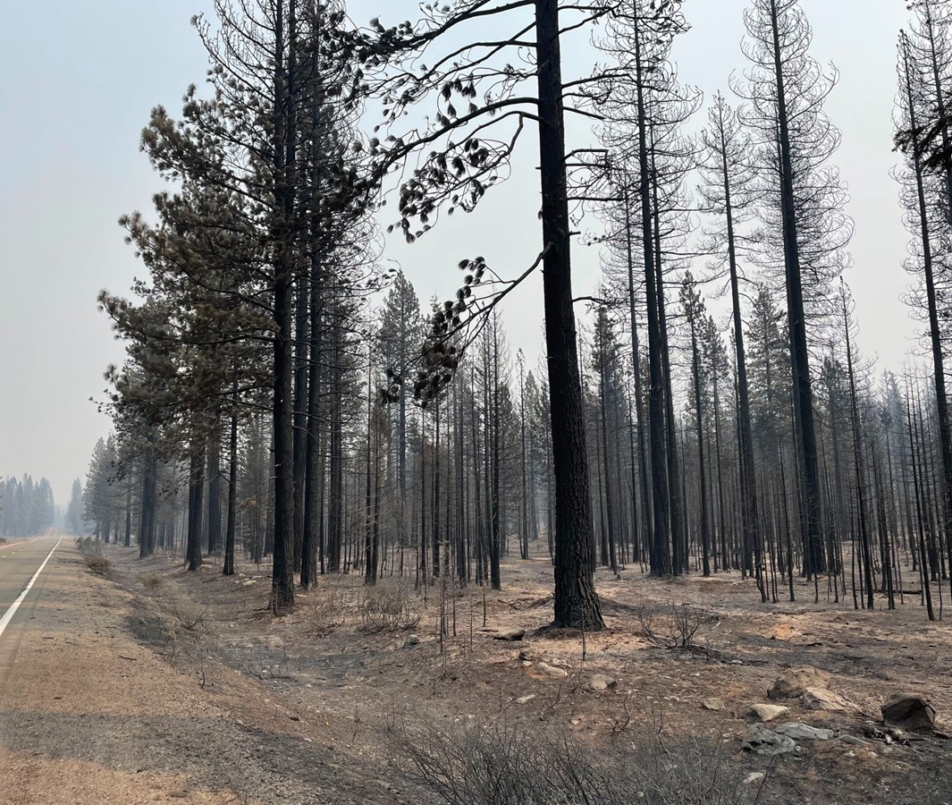
High-severity fire
Increasing HS patch size
Increasing area affected
Scott Rodd, capRadio
Notes:
Problem 1: too much HS fire
PILA is fire-adapted, but with a fire-resisting life history strategy
Fire suppression -> fuels + climate change = increases in HS fire
Increasing patch size, increasing area affected

Slide 4
Cronartium ribicola (White pine blister rust)
Dudney et al., (2020) Ecosphere
Geils et al., (2010) Forest Pathology
Notes:
Invasive fungal pathogen cronartium ribicola
Introduced to north America early 20th century, now spread across much of PILA’s range
Infection reduces vigor and can kill by girdling stems, esp small ones
Major threat an endangered relative of PILA
lots of concern from managers / policymakers

Slide 5
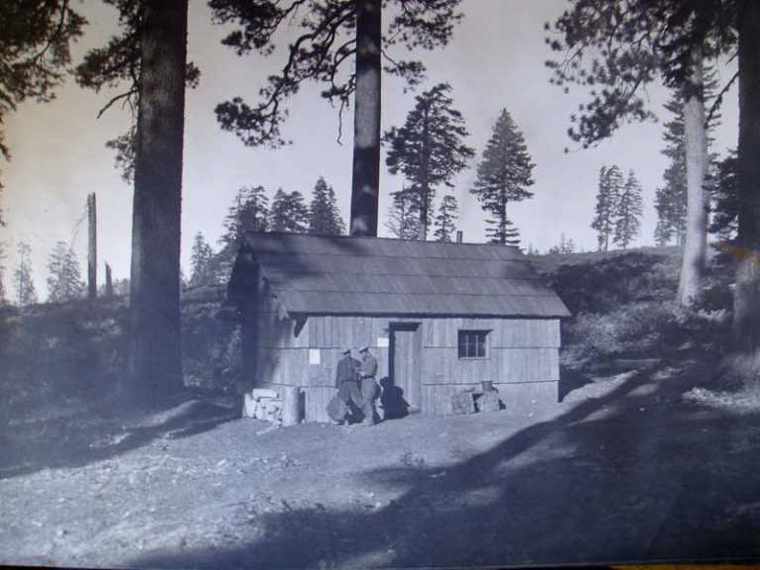
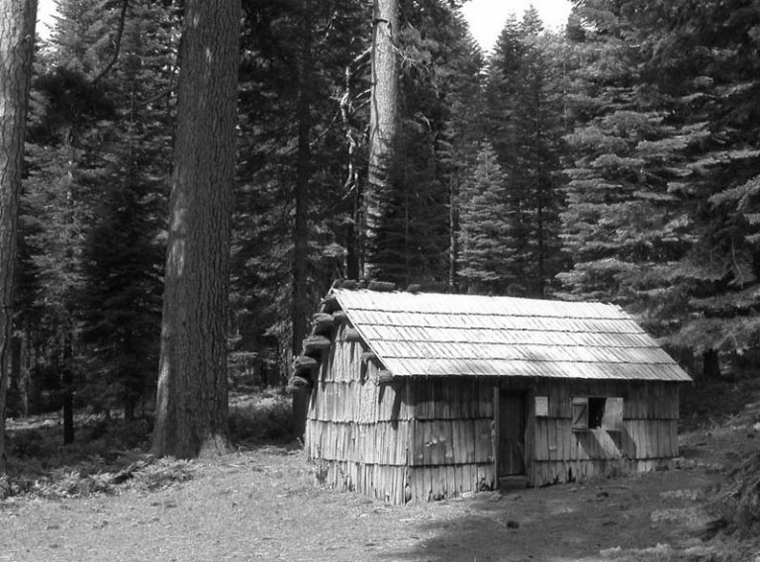
Densification
Plumas National Forest
Plumas National Forest

Slide 6
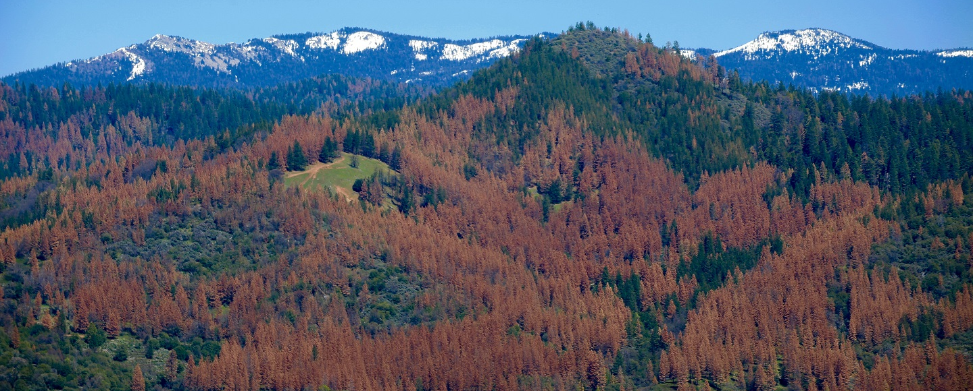
Drought and bark beetles
NASA

Slide 7
Questions
What is the relative importance of the various stressors affecting sugar pine?
What is the current status and trajectory of the ensemble of sugar pine populations across its range?

Slide 8
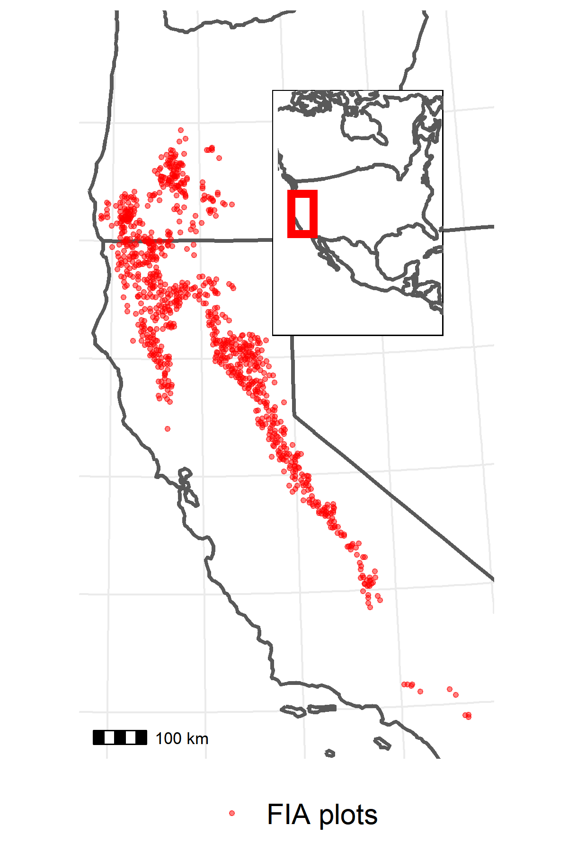
Data
US Forest Service Forest Inventory and Analysis (FIA) plot network
956 plots within mapped PILA range and with PILA present
Included harvested plots
1/10th of plots visited every year since 2001
~10 years between visits, 2 visits per plot
On each plot:
Inventory of trees: Species, live/dead, diameter at breast height (DBH), evidence of damage/disease (e.g., WPBR)
Tally of seedlings by species
Presence of disturbances (e.g., fire)
TerraClimate dataset to estimate mean growing season climatic water deficit (CWD) at each plot location in each year

Slide 9
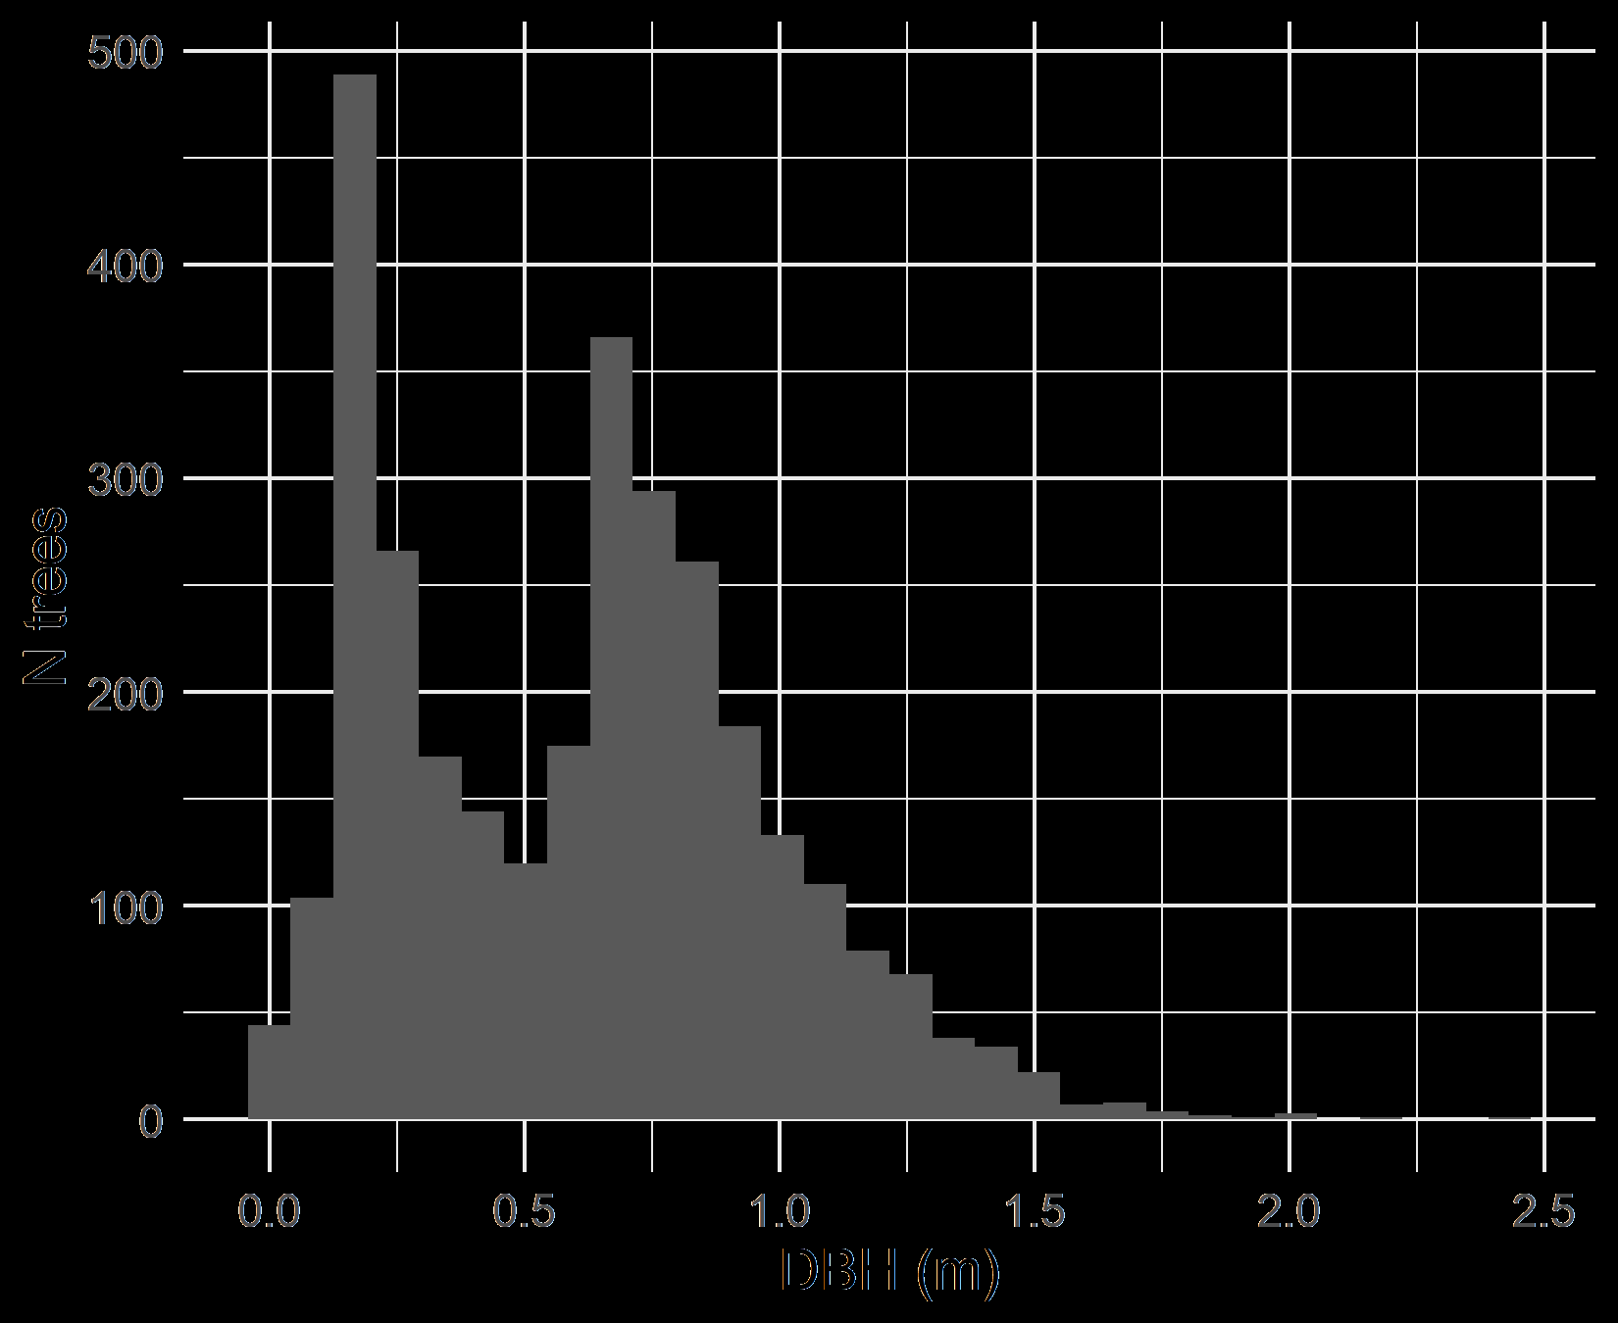
Data II
Explanatory variables
Size
DBH at initial census
Fire
T/F; between initial and remeasurement
WPBR
T/F; present at initial
Density
Subplot basal area at initial
Drought
90th percentile CWD departure between initial and remeasurement
Site dryness
Mean CWD from 2000-2020
All 2-way interactions with size

Slide 10
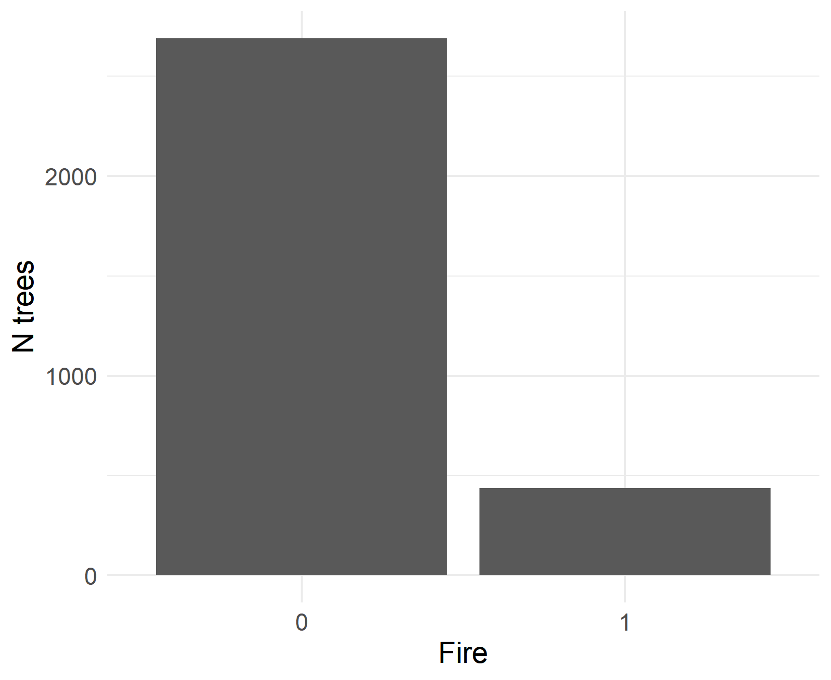
Data II
Explanatory variables
Size
DBH at initial census
Fire
T/F; between initial and remeasurement
WPBR
T/F; present at initial
Density
Subplot basal area at initial
Drought
90th percentile CWD departure between initial and remeasurement
Site dryness
Mean CWD from 2000-2020
All 2-way interactions with size

Slide 11
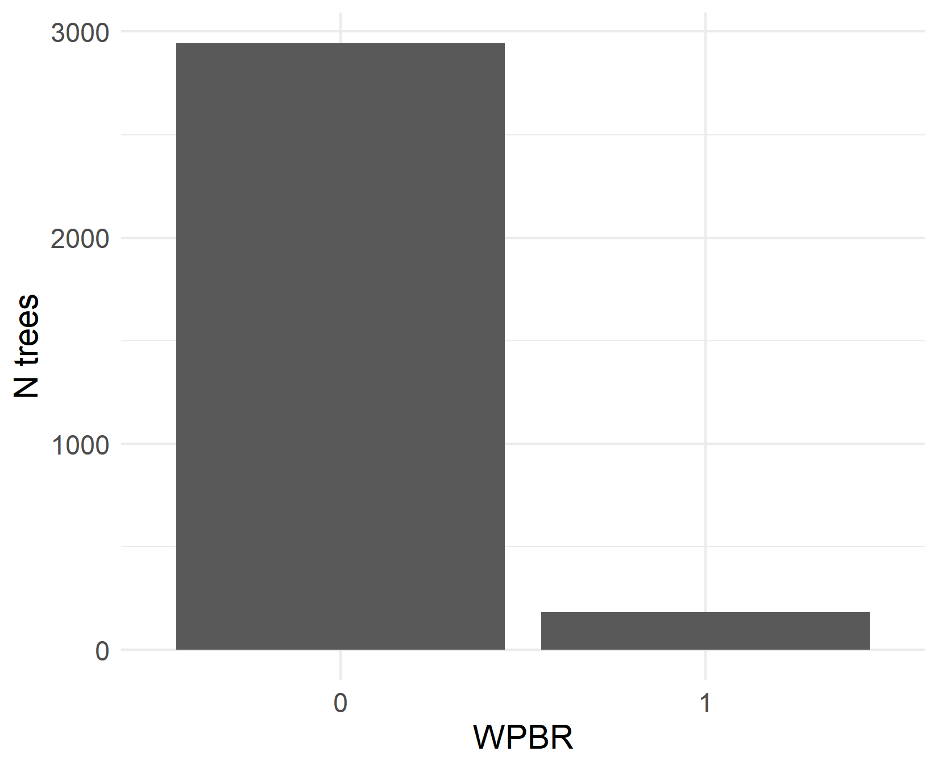
Data II
Explanatory variables
Size
DBH at initial census
Fire
T/F; between initial and remeasurement
WPBR
T/F; present at initial
Density
Subplot basal area at initial
Drought
90th percentile CWD departure between initial and remeasurement
Site dryness
Mean CWD from 2000-2020
All 2-way interactions with size

Slide 12
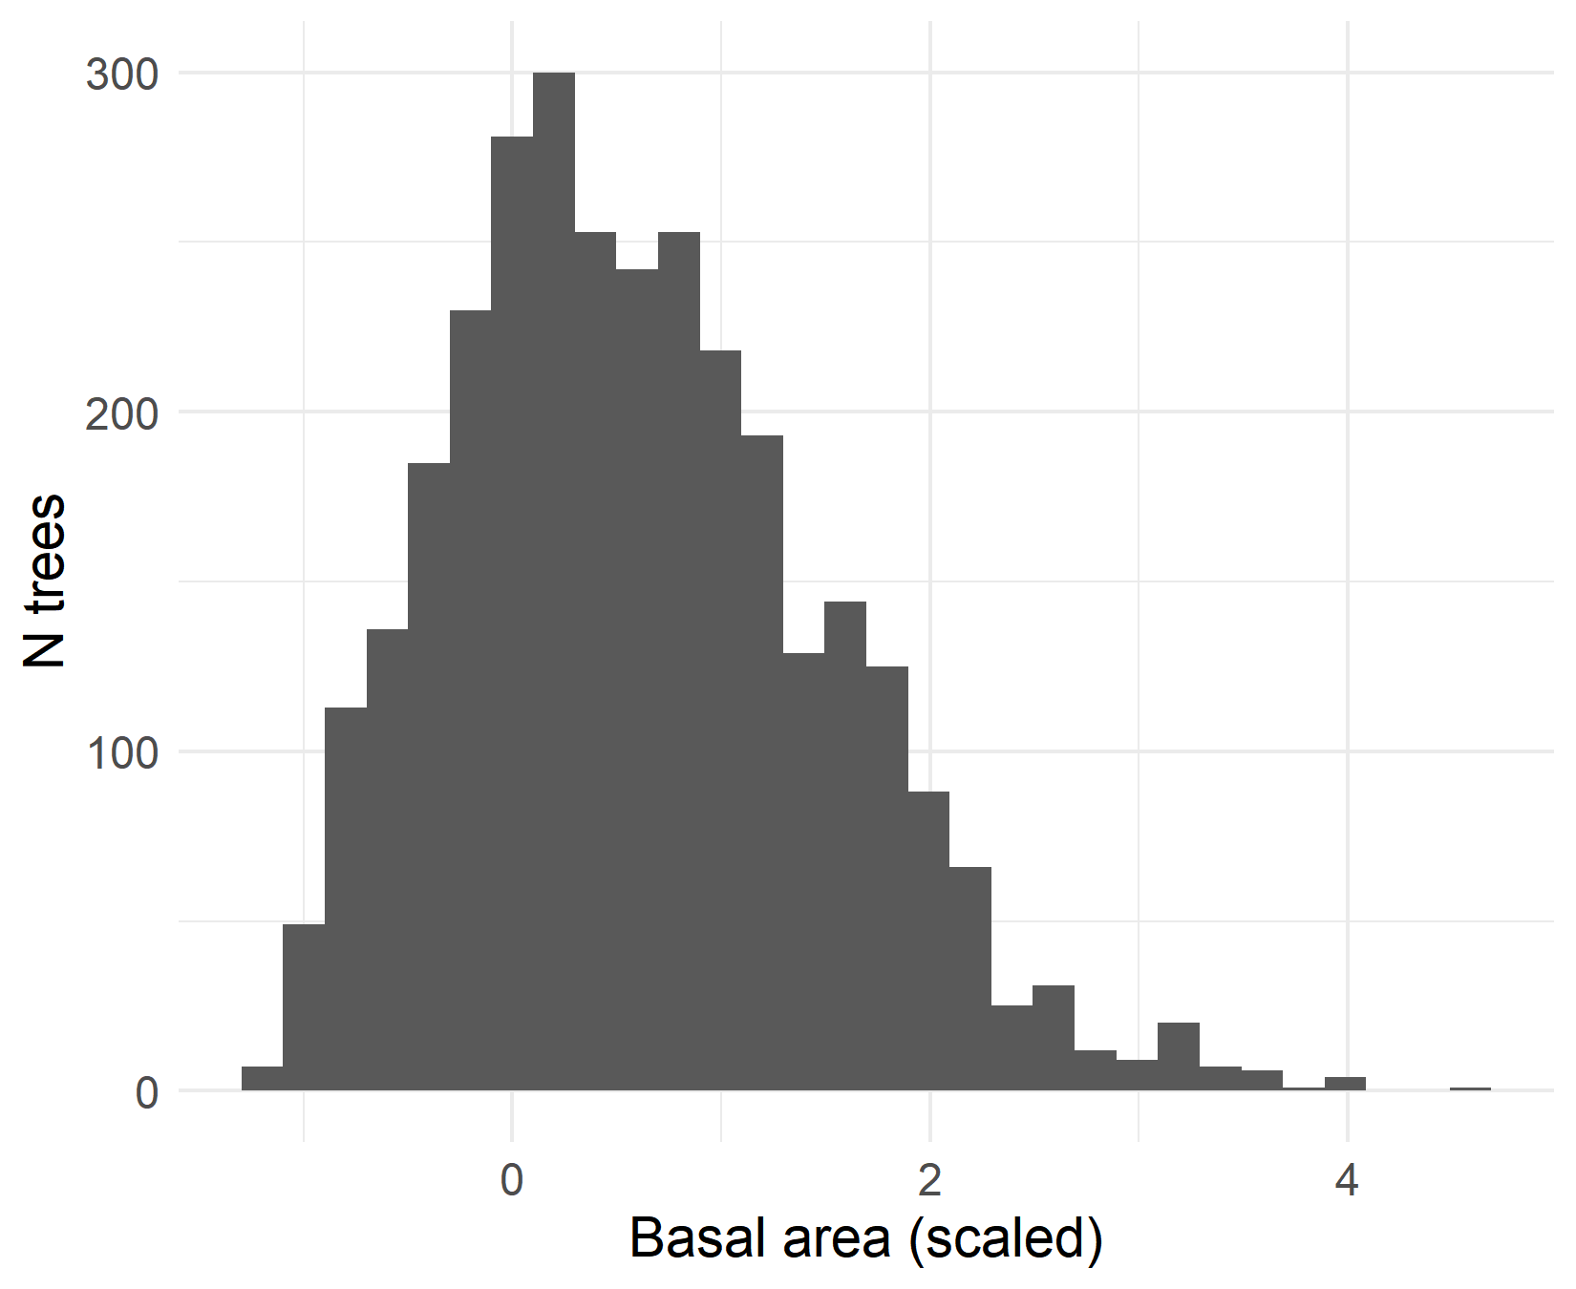
Data II
Explanatory variables
Size
DBH at initial census
Fire
T/F; between initial and remeasurement
WPBR
T/F; present at initial
Density
Subplot basal area at initial
Drought
90th percentile CWD departure between initial and remeasurement
Site dryness
Mean CWD from 2000-2020
All 2-way interactions with size

Slide 13
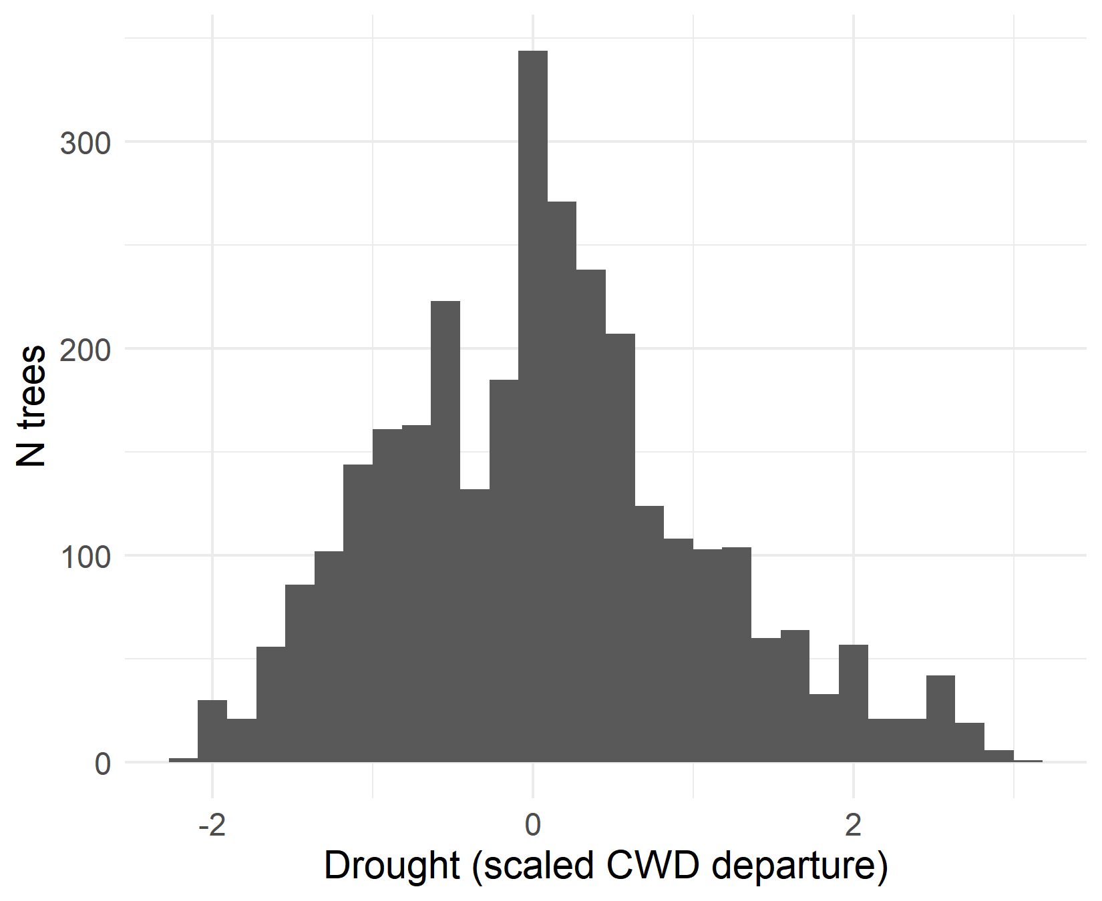
Data II
Explanatory variables
Size
DBH at initial census
Fire
T/F; between initial and remeasurement
WPBR
T/F; present at initial
Density
Subplot basal area at initial
Drought
90th percentile CWD departure between initial and remeasurement
Site dryness
Mean CWD from 2000-2020
All 2-way interactions with size

Slide 14
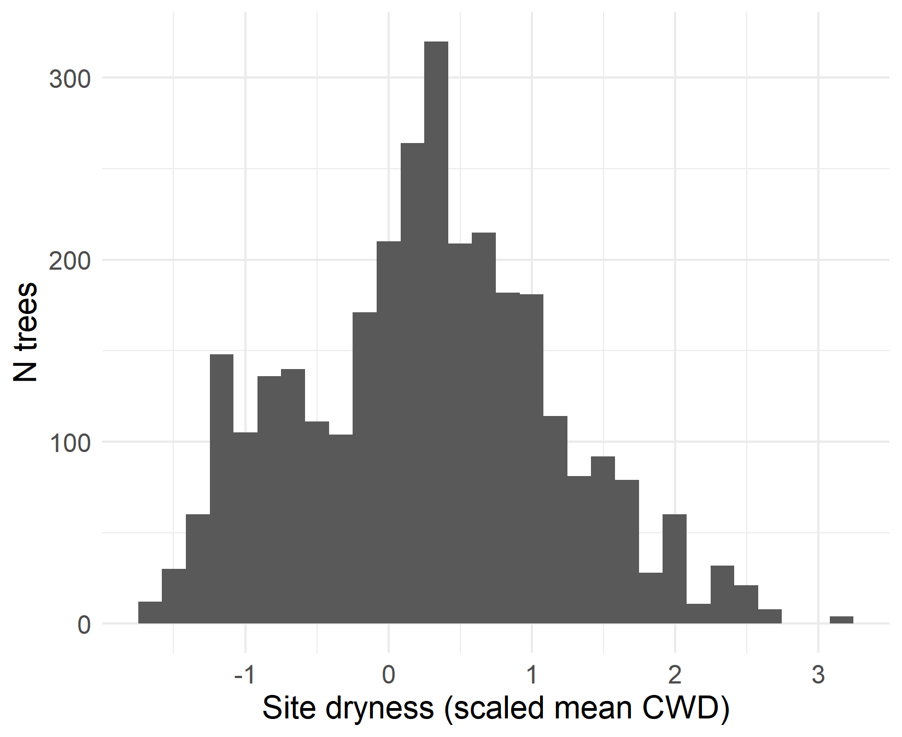
Data II
Explanatory variables
Size
DBH at initial census
Fire
T/F; between initial and remeasurement
WPBR
T/F; present at initial
Density
Subplot basal area at initial
Drought
90th percentile CWD departure between initial and remeasurement
Site dryness
Mean CWD from 2000-2020
All 2-way interactions with size

Slide 15
Data II
Explanatory variables
Size
DBH at initial census
Fire
T/F; between initial and remeasurement
WPBR
T/F; present at initial
Density
Subplot basal area at initial
Drought
90th percentile CWD departure between initial and remeasurement
Site dryness
Mean CWD from 2000-2020
All 2-way interactions with size

Slide 16
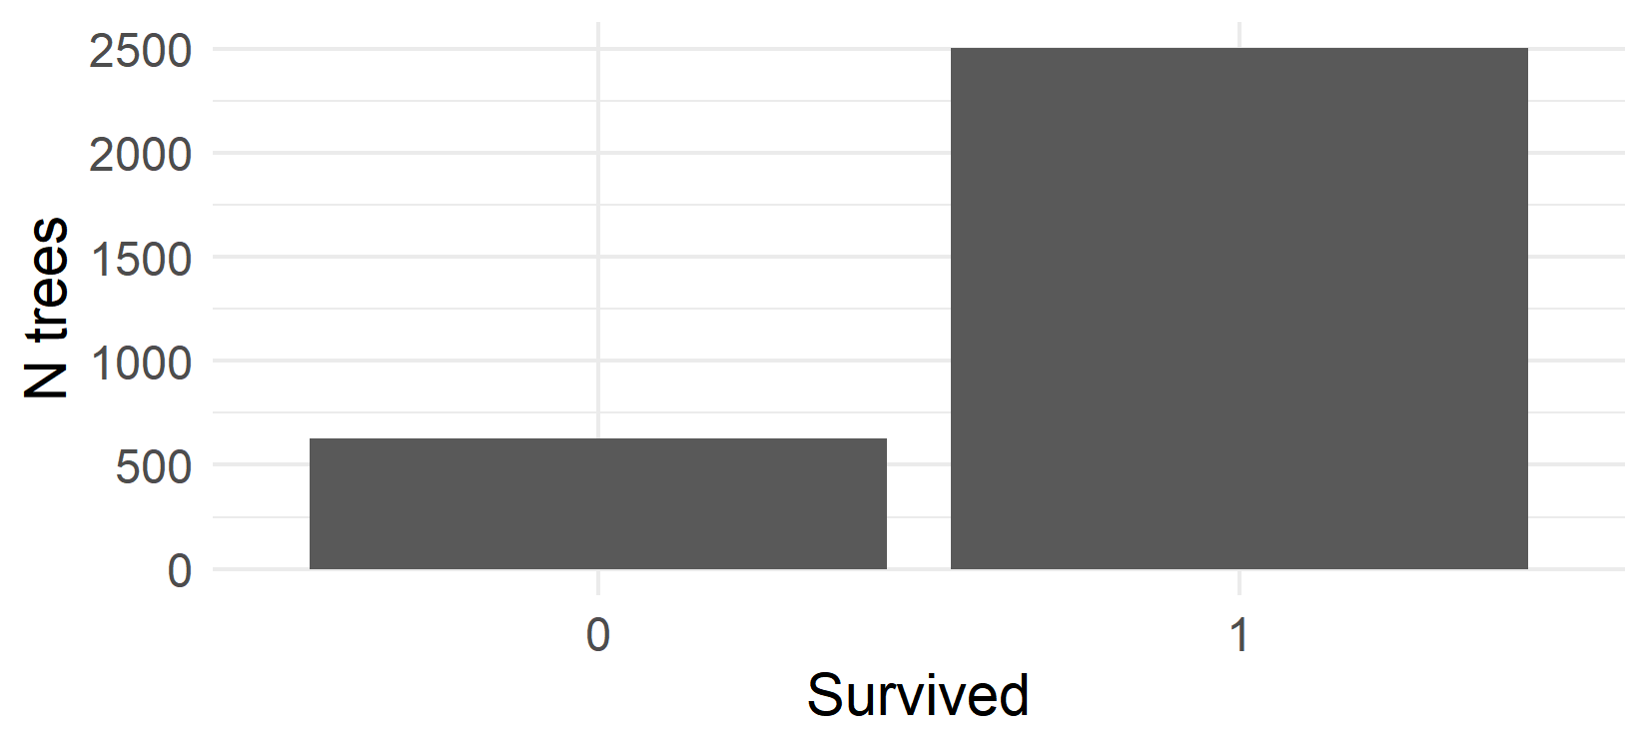
Data II
Explanatory variables
Size
DBH at initial census
Fire
T/F; between initial and remeasurement
WPBR
T/F; present at initial
Density
Subplot basal area at initial
Drought
90th percentile CWD departure between initial and remeasurement
Site dryness
Mean CWD from 2000-2020
All 2-way interactions with size
Response variables
Survival
T/F; alive at remeasurement
Growth
Size at remeasurement
N untagged trees at remeasurement

Slide 17
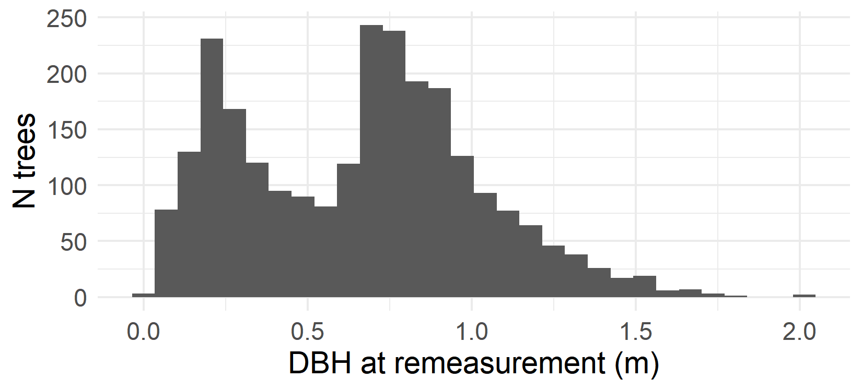
Data II
Explanatory variables
Size
DBH at initial census
Fire
T/F; between initial and remeasurement
WPBR
T/F; present at initial
Density
Subplot basal area at initial
Drought
90th percentile CWD departure between initial and remeasurement
Site dryness
Mean CWD from 2000-2020
All 2-way interactions with size
Response variables
Survival
T/F; alive at remeasurement
“Growth”
Size at remeasurement
N untagged trees at remeasurement

Slide 18
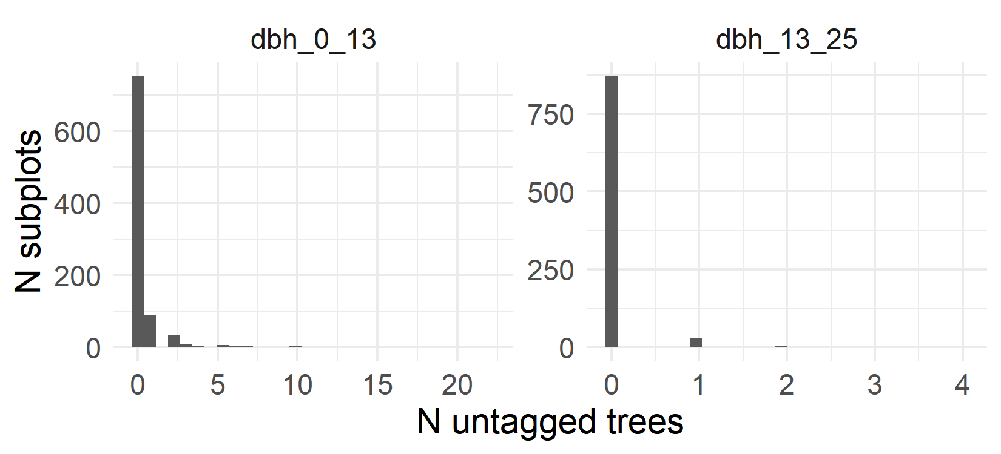
Data II
Explanatory variables
Size
DBH at initial census
Fire
T/F; between initial and remeasurement
WPBR
T/F; present at initial
Density
Subplot basal area at initial
Drought
90th percentile CWD departure between initial and remeasurement
Site dryness
Mean CWD from 2000-2020
All 2-way interactions with size
Response variables
Survival
T/F; alive at remeasurement
Growth
Size at remeasurement
N untagged trees at remeasurement

Slide 19
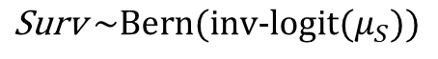
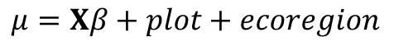
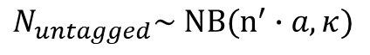
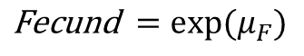
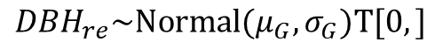
Analysis
Explanatory variables
Vital rate functions
Survival
Integral projection model
Fire
WPBR
Basal area
Drought
Site dryness
Growth
Fecundity
Size-class transition matrix
Asymptotic population growth rate
Interactions with DBH
DBH
$$\text{S}\text{urv} \sim \text{Bern}\text{(}\text{inv}\text{−}\text{logit}(μ_{S}))$$
$${DBH}_{re}\sim \text{Normal}\text{(}μ_{G}, σ_{G})T[0,]$$
$$\text{F}\text{ecund} =exp⁡(μ_{F})$$
$$μ=Xβ+plot+ecoregion$$
$$N_{untagged}\sim \text{N}B(n^{′}∙a, κ)$$
Based on Shriver et al. (2021)

Slide 20
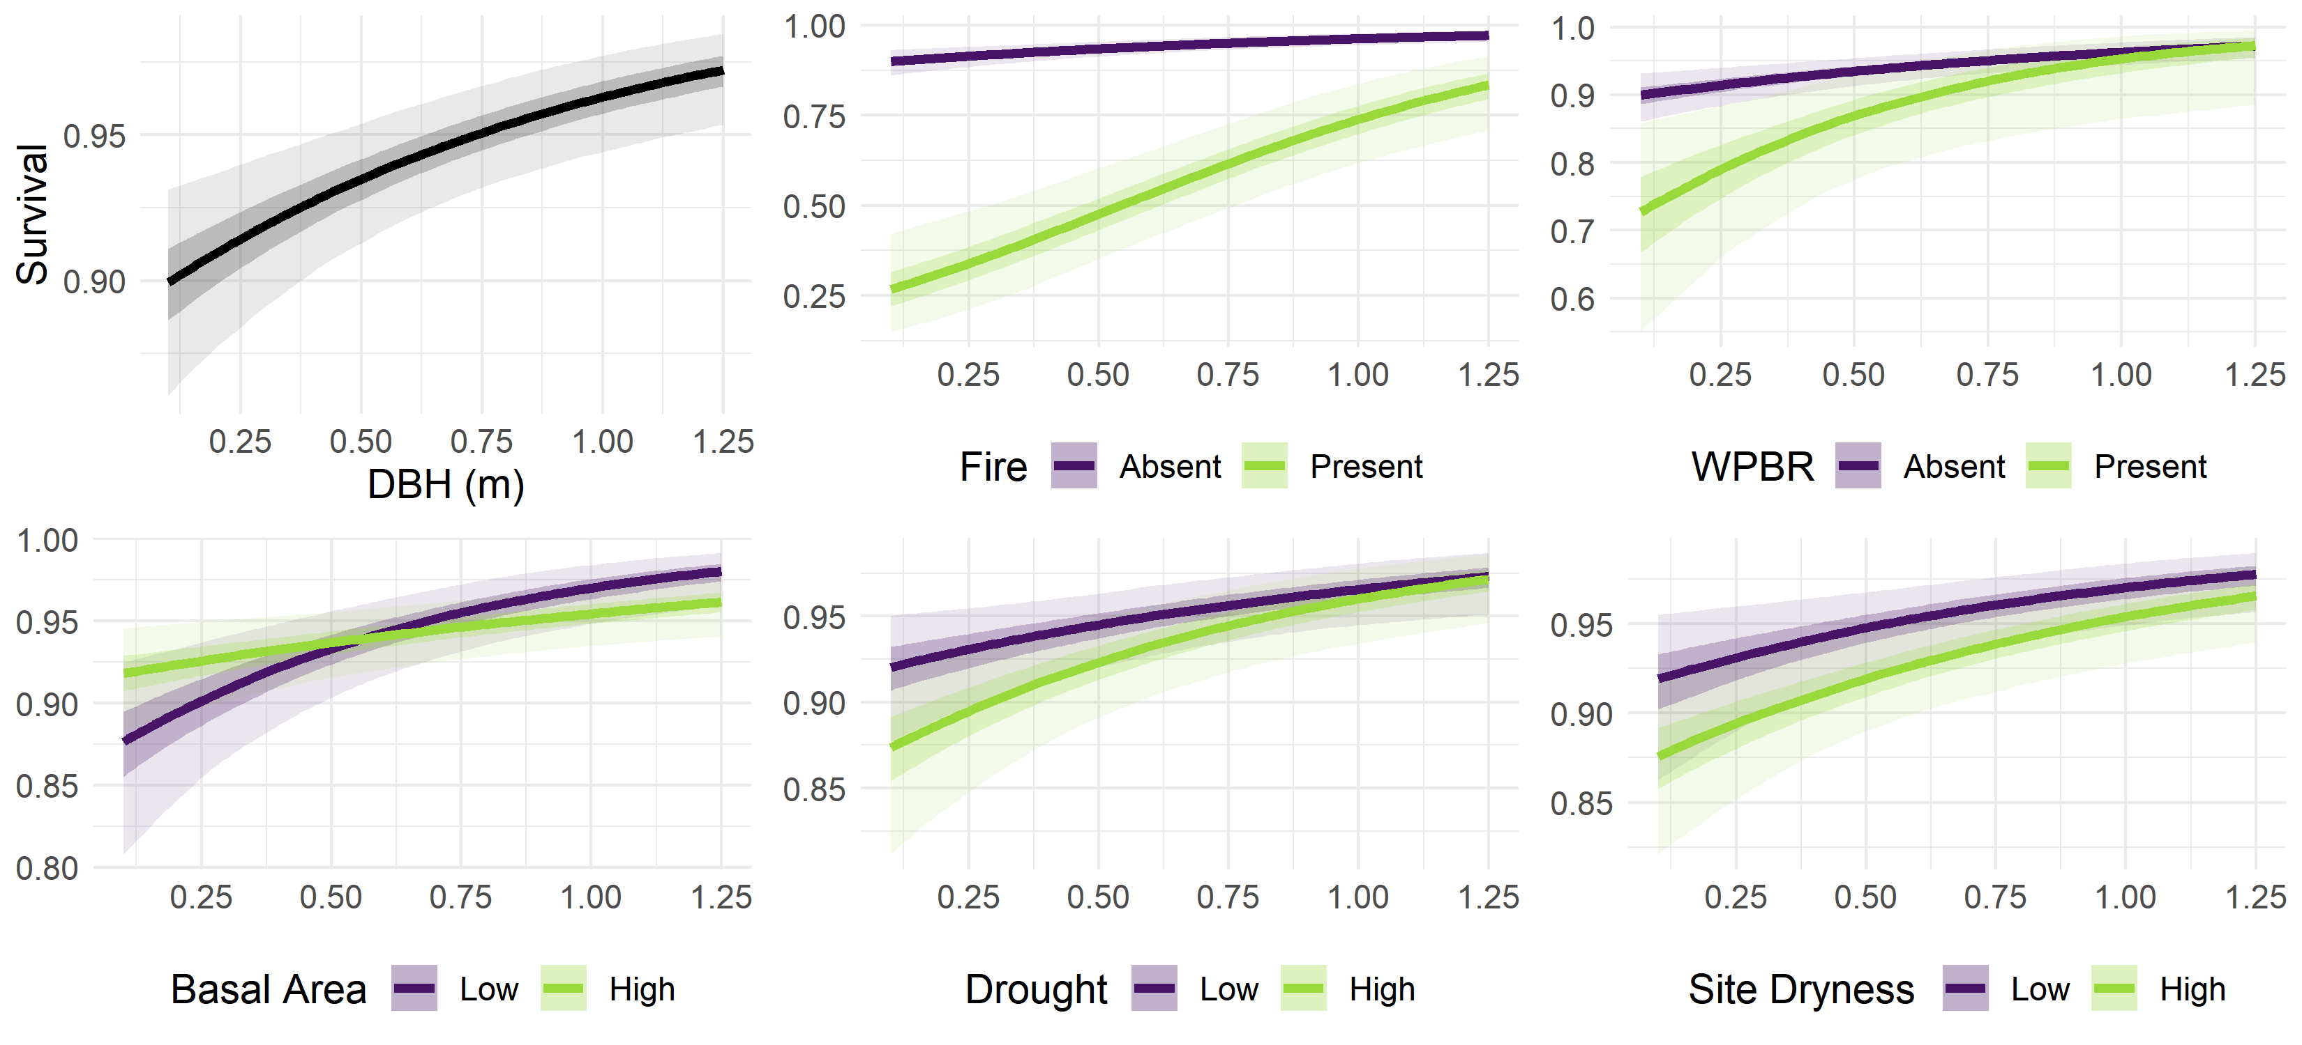
Results: Survival
Notes:
Figure: effects plot, showing the predicted response (y axis) given some assumed explanatory variables (x axis and color);
The focal effects vary along the x axis and color, and all other explanatory variables are held at 0 (false or the mean)
E.g. size graph in the top left shows predicted survival for hypothetical trees with dbh 0-1.25, assuming no FIRE or WPBR, and mean BA, Drought, and Dryness, same as the purple line in the fire graph top middle
Green line in the fire graph (top middle) shows predicted survival for a range of sizes, assuming fire occurred on the plot
Size: + main
Fire: -- main, + interaction
WPBR: -- main, 0 interaction
BA: + main, - interaction
Drought: - main, 0 interaction
Dryness: 0 main, 0 interaction

Slide 21
Results: Survival
Notes:
E.g. size graph in the top left shows predicted survival for hypothetical trees with dbh 0-1.25, assuming no FIRE or WPBR, and mean BA, Drought, and Dryness, same as the purple line in the fire graph top middle
Green line in the fire graph (top middle) shows predicted survival for a range of sizes, assuming fire occurred on the plot
Size: + main
Fire: -- main, + interaction
WPBR: -- main, 0 interaction
BA: + main, - interaction
Drought: - main, 0 interaction
Dryness: 0 main, 0 interaction

Slide 22
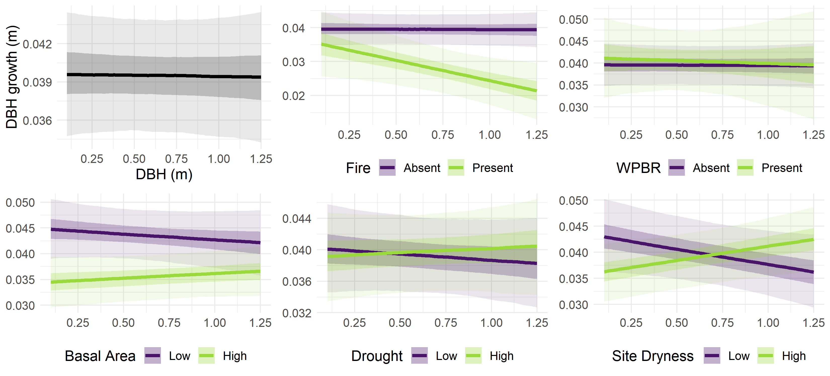
Results: Growth
Notes:
Similar effects plots, now with growth (difference between size0 and sizeT) on the y axis
Intercept: 0.035-0.044
Fire: 0 main, - interaction
WPBR: 0 main, 0 interaction
BA: - main, 0 interaction
Drought: 0 main, 0 interaction
Dryness: - main, + interaction

Slide 23
Results: Growth
Notes:
Intercept: 0.035-0.044
Fire: 0 main, - interaction
WPBR: 0 main, 0 interaction
BA: - main, 0 interaction
Drought: 0 main, 0 interaction
Dryness: - main, + interaction

Slide 24
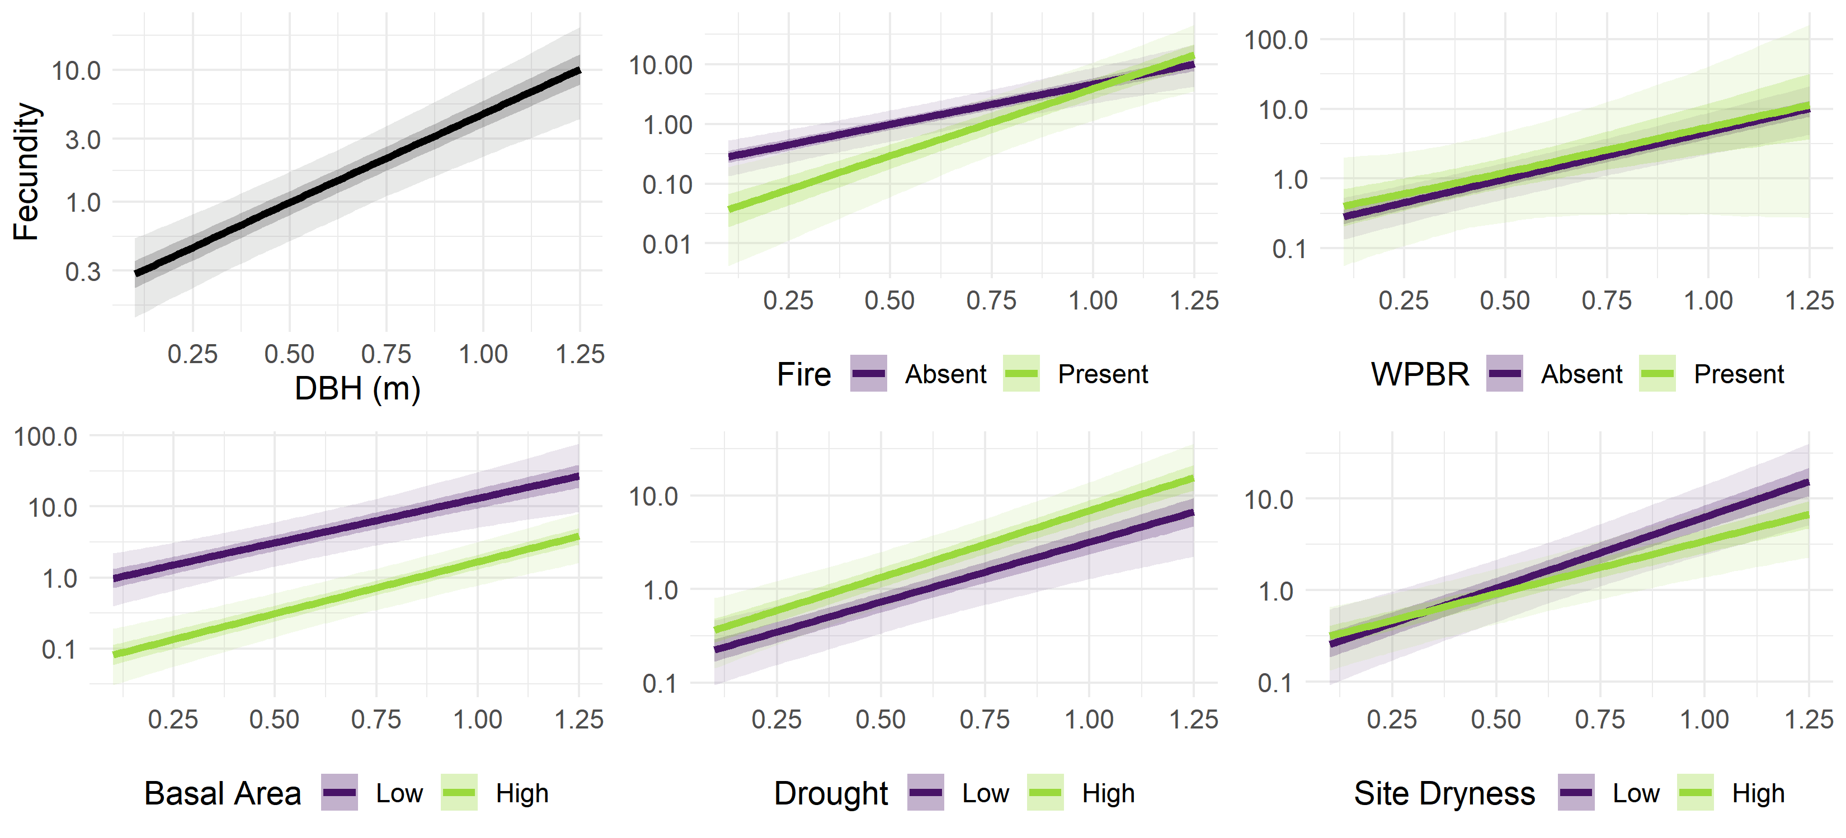
Results: Fecundity
Notes:
Size: + main
Fire: - main, + interaction
WPBR: 0 main, 0 interaction
BA: - main, 0 interaction
Drought: 0 main, 0 interaction
Dryness: 0 main, 0 interaction

Slide 25
Results: Fecundity
Notes:
Size: + main
Fire: - main, + interaction
WPBR: 0 main, 0 interaction
BA: - main, 0 interaction
Drought: 0 main, 0 interaction
Dryness: 0 main, 0 interaction

Slide 26
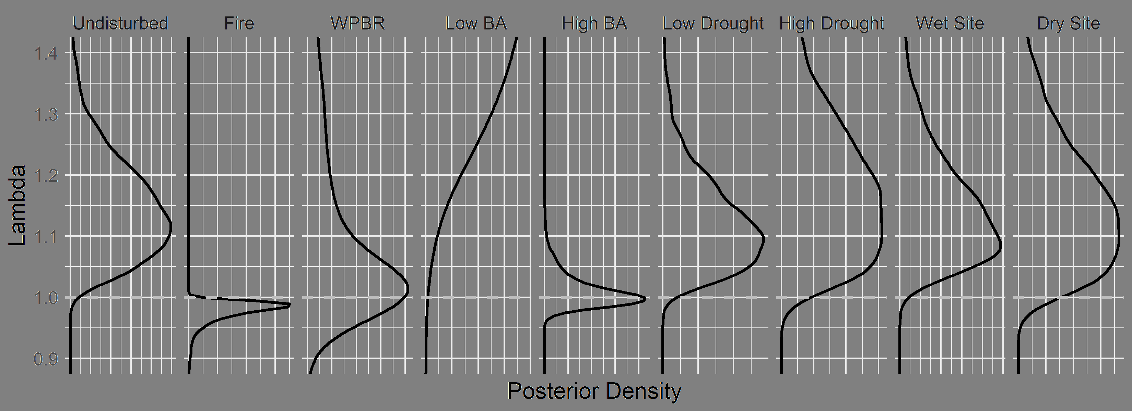
Results: Stressor effects on asymptotic population growth rate
Notes:
Figure: vital rates synthesized into an IPM, extracting the posterior asymptotic pop growth rate for each scenario

Slide 27
Results: Stressor effects on asymptotic population growth rate
Notes:
Fire: 90% CI for lambda is lower than 1; clear that fire negatively affects the trajectory of population growth
Low BA: 90% CI for lambda is way above 1: low basal area really boosts the trajectory of population growth

Slide 28
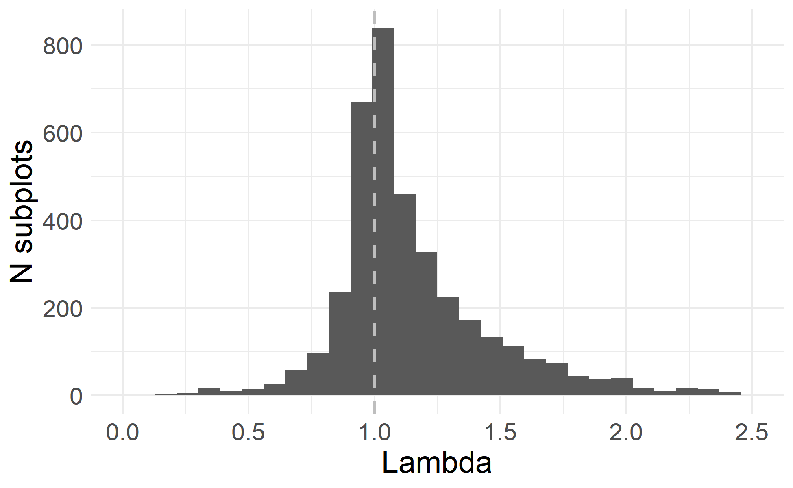
Results: Asymptotic population growth rate across sampled subplots
IQR 0.98 to 1.29
Median 1.07
Lambda < 1 on 34.6% of subplots
Assumes conditions held constant over time
Notes:
Figure: histogram of the predicted lambda (using posterior median parameter values) across the range of actual subplots where PILA was present
On the average subplot, population is predicted to slowly increase assuming conditions are held constant
On a third of subplots, population is predicted to decline assuming conditions are held constant
“Constant conditions” is not a realistic assumption (e.g. burned subplots probably wont get reburned every 10 years, unburned subplots may get burned), so care needed to interpret this figure

Slide 29
Management implications
Insights:
Fire and density are key stressors
Demographic value of large/old individuals
Responses:
Fuel treatments
Density reduction

Slide 30
Feedback items
How to pitch / frame a paper for FEM / CJFR
“How should we conserve sugar pine?” (why care?)
“How are stressors affecting the mixed conifer forest type?” (too complex?)
“Here’s a way to prioritize management for species of concern” (methods paper w/o new methods)
Presentation feedback
North American Forest Ecology Workshop (~15 mins)

